Slide 1

#TeamNannyState

Slide 2
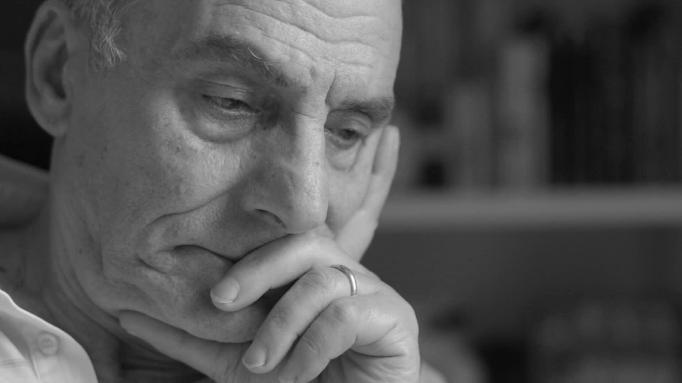
Populations are getting older
By 2031, 21% of New Zealanders will be over 65 (Currently 13%)
Leading cause of death in New Zealand for people over 65
30% of all seniors over 65 will have a fall each year
Right Now 193,000 falls are happening each year in New Zealand Alone!

Slide 3
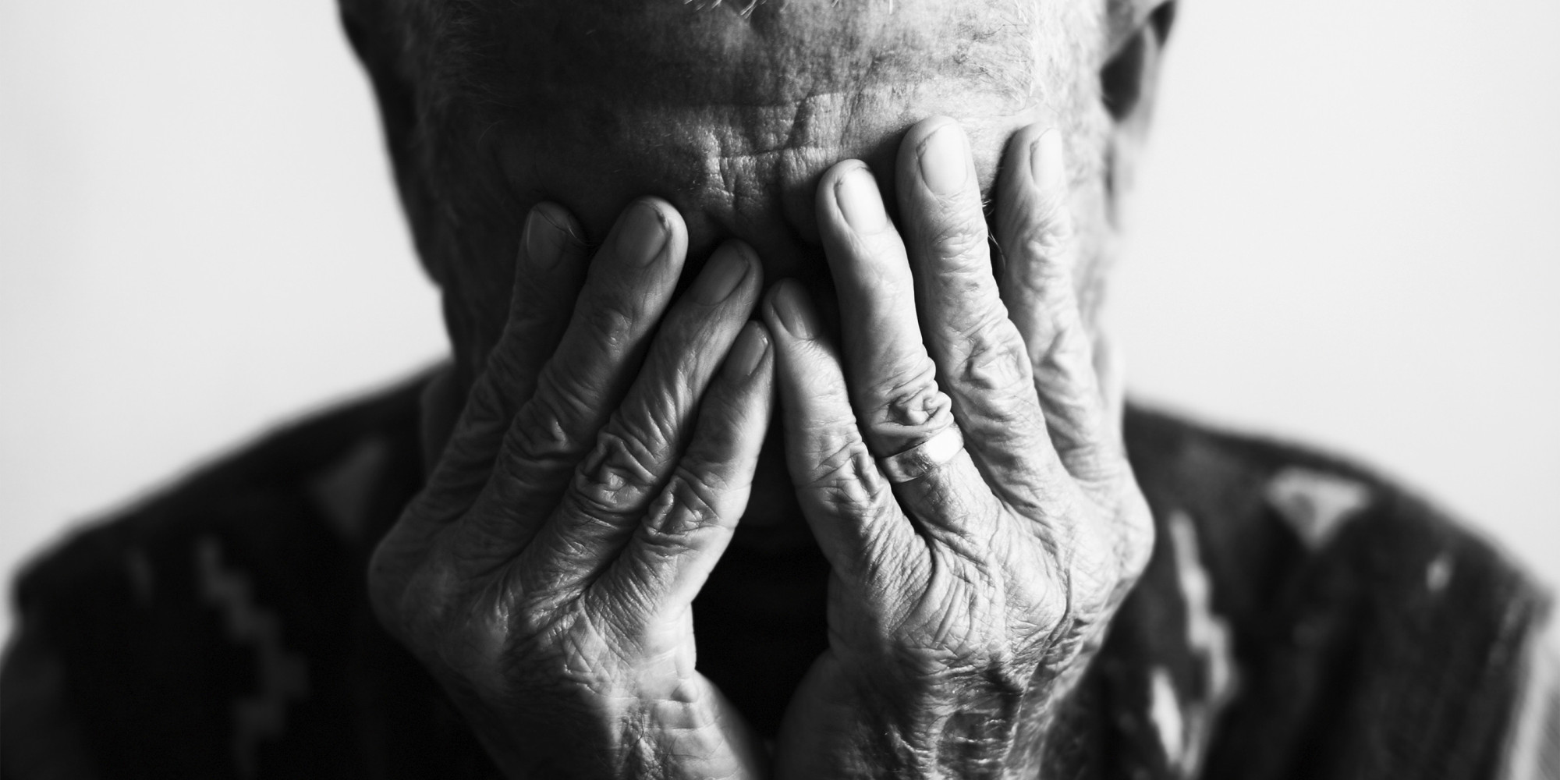
50% of seniors need help from someone else
90% of all seniors who receive assistance within the first hour can continue to live independently
30% of all seniors that fall will be on the floor more than an hour
Timely Medical Attention Saves lives.

Slide 4
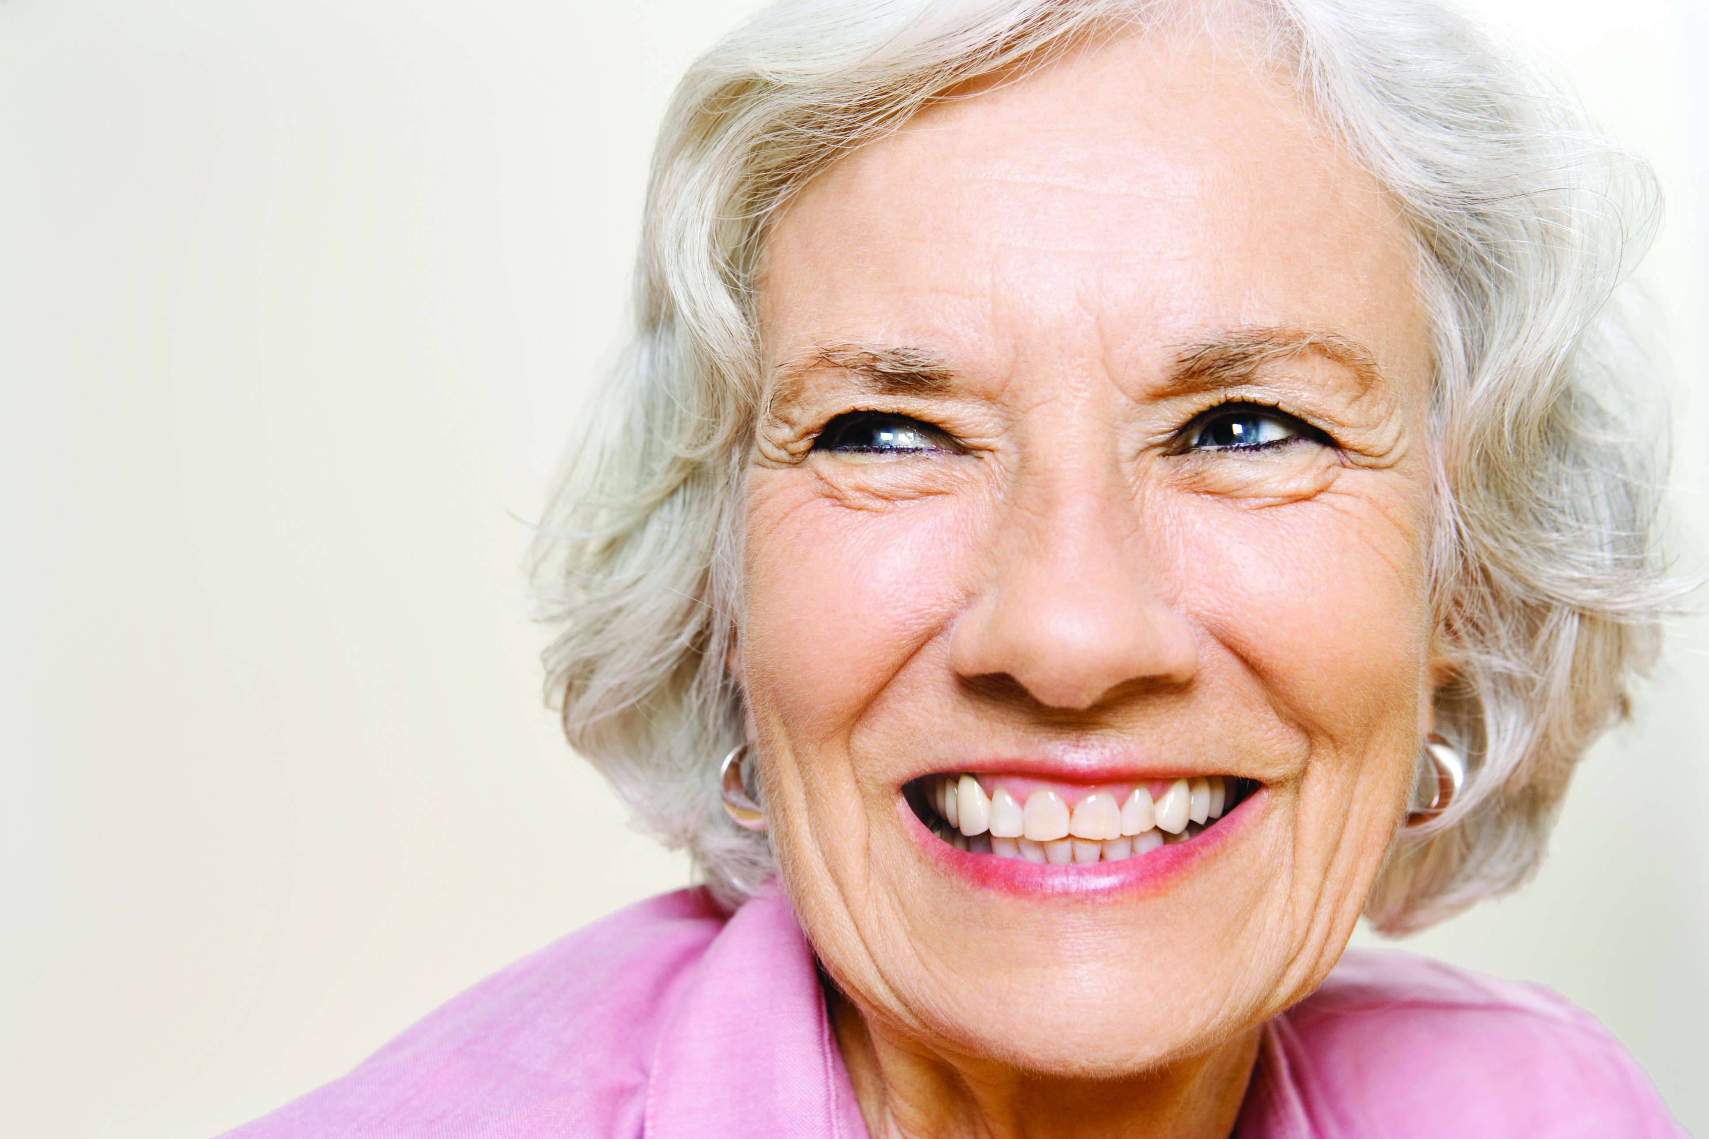



Slide 5
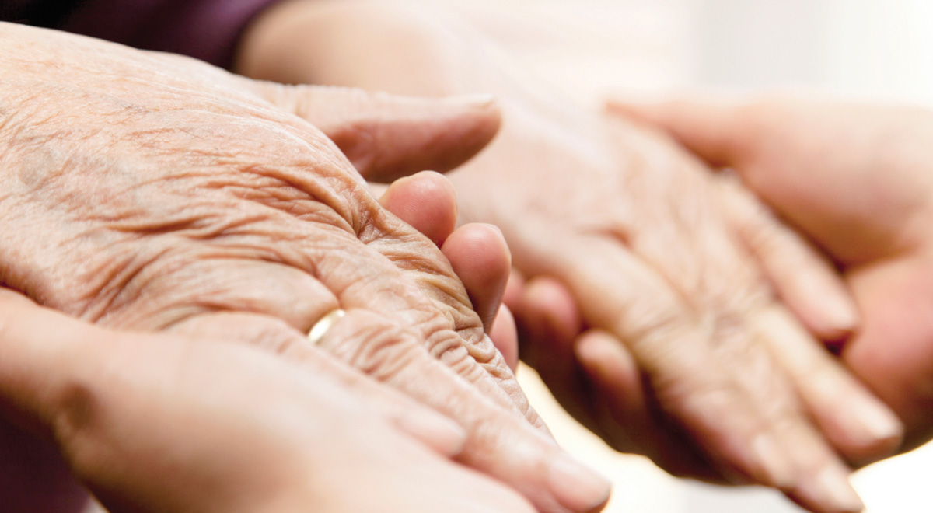

Peace

Slide 6
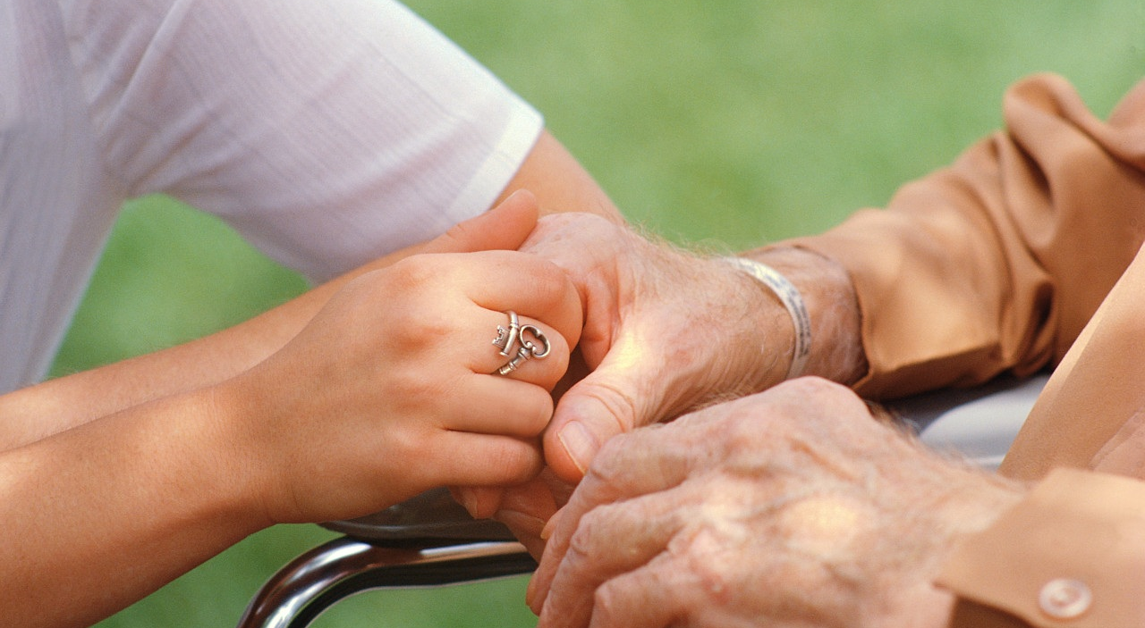
Support

Slide 7
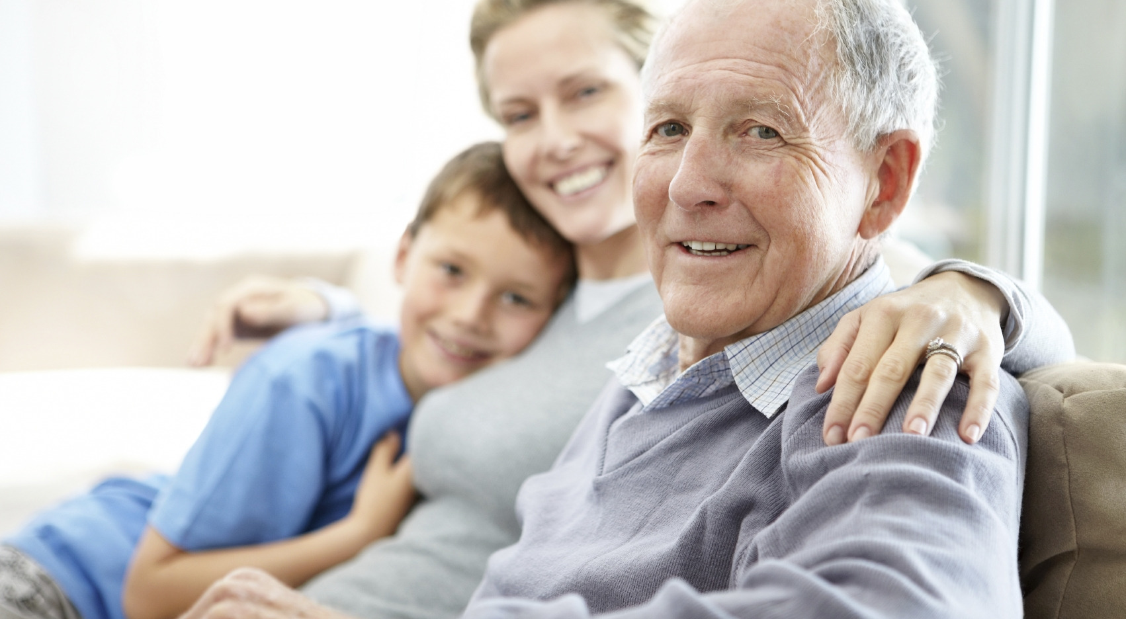
Family

Slide 8

Respond

Slide 9
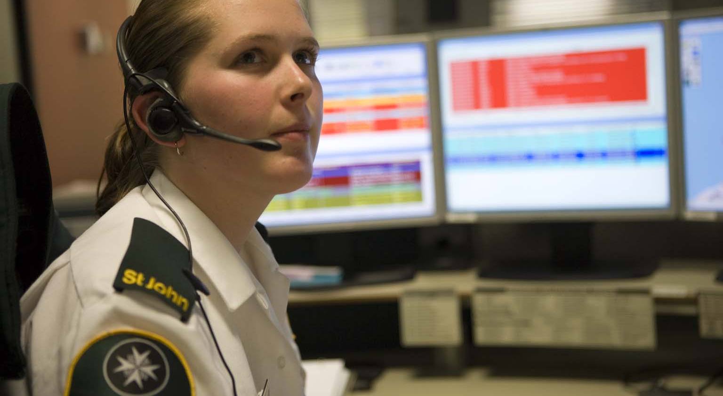
With You

Slide 10

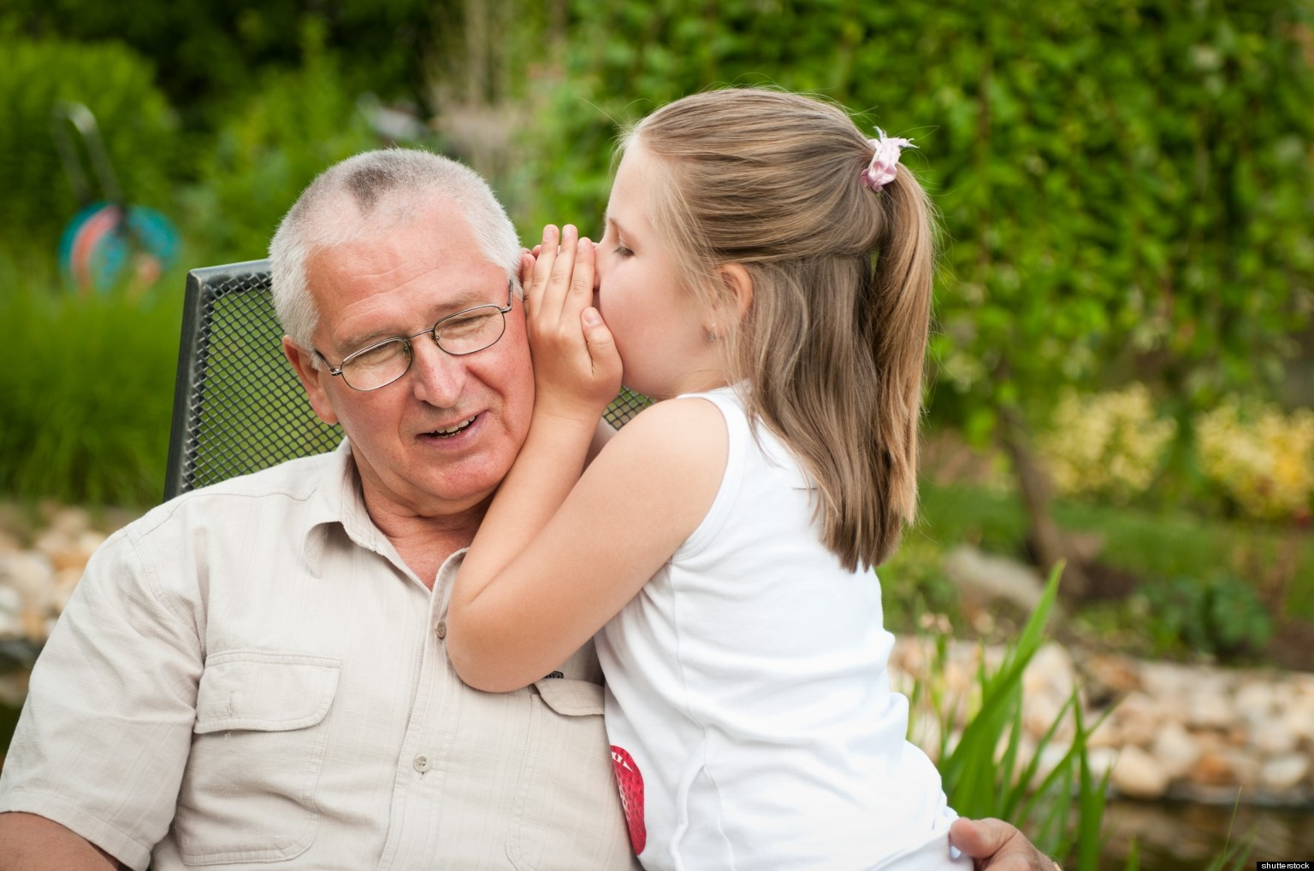

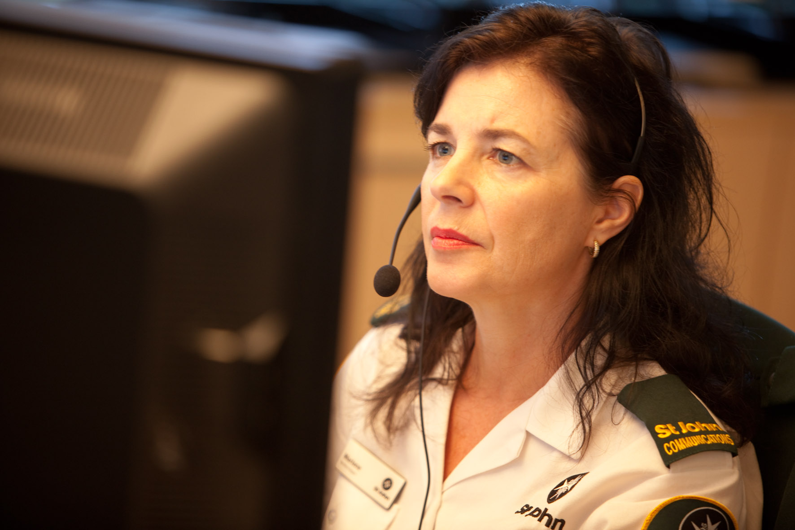
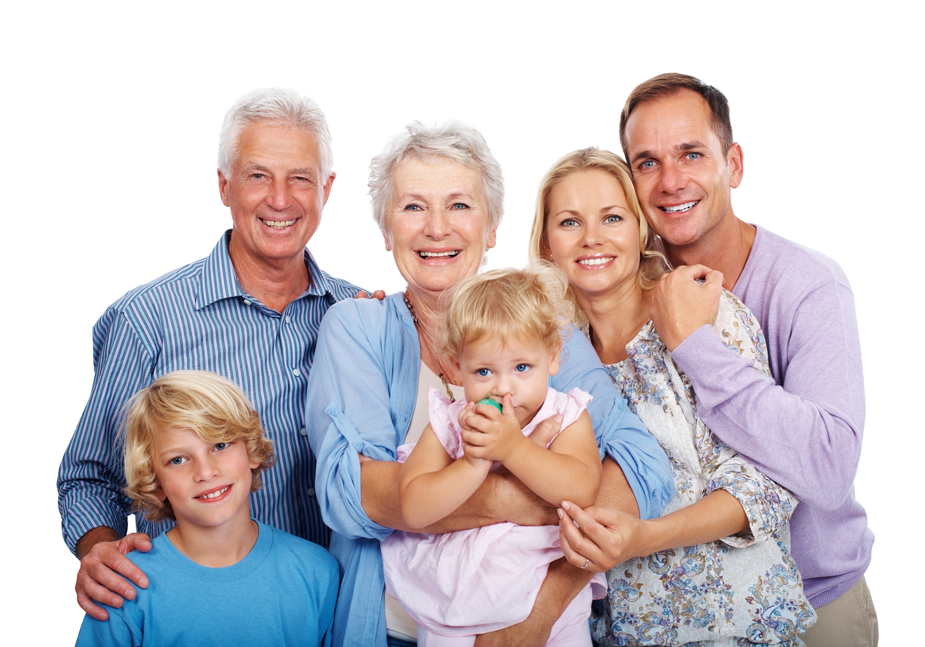
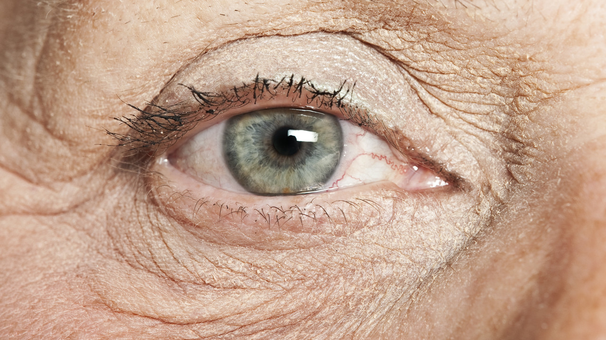
Insight

Slide 11
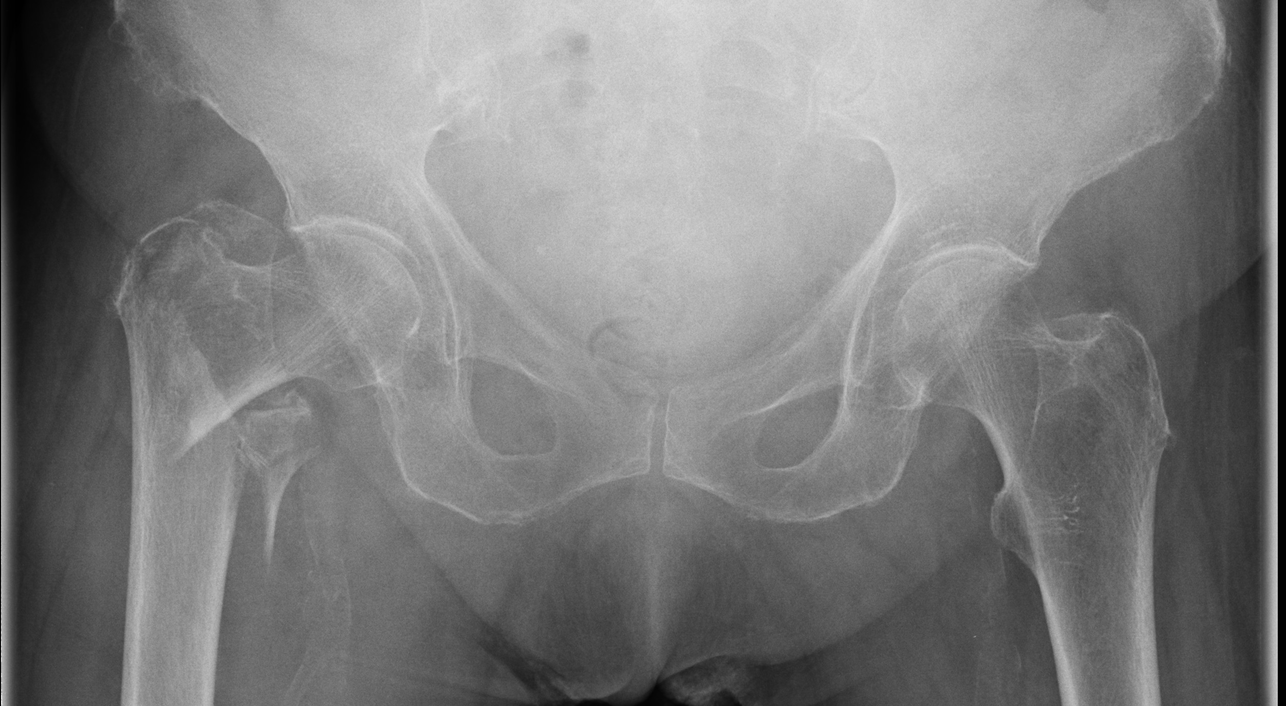
Prevent

Slide 12
Invest

Slide 13
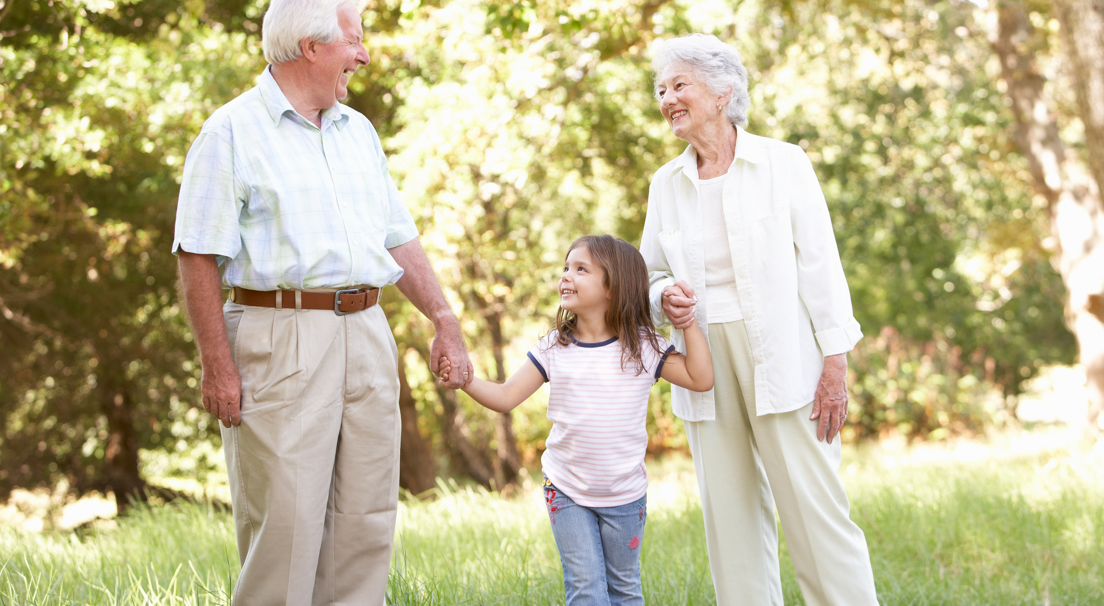
Wherever

Slide 14
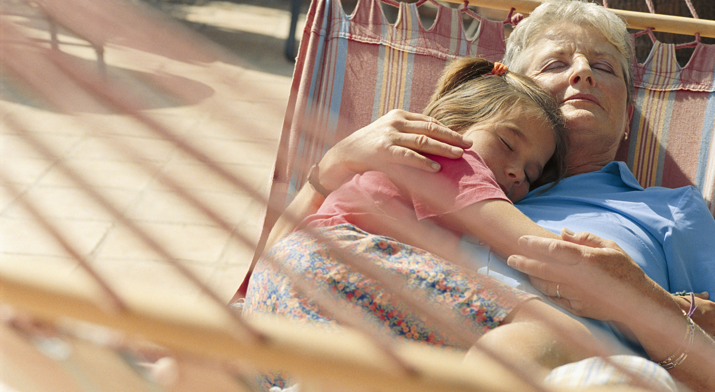
Safe.

Slide 15





